Slide 1
find a partner

Slide 2
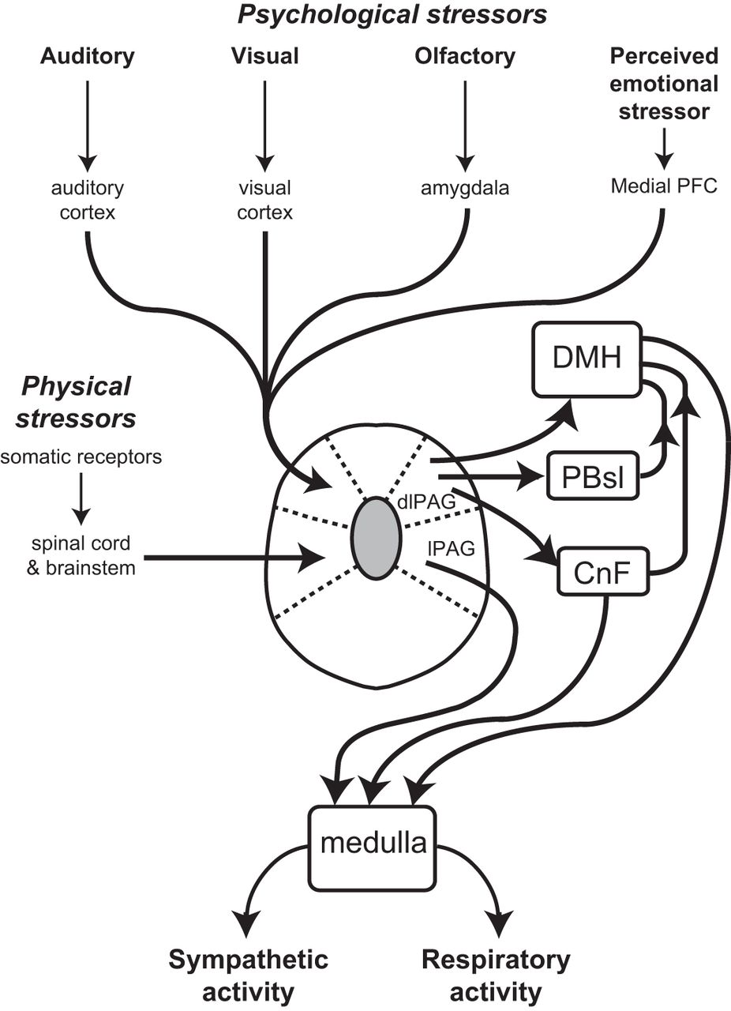

Slide 3
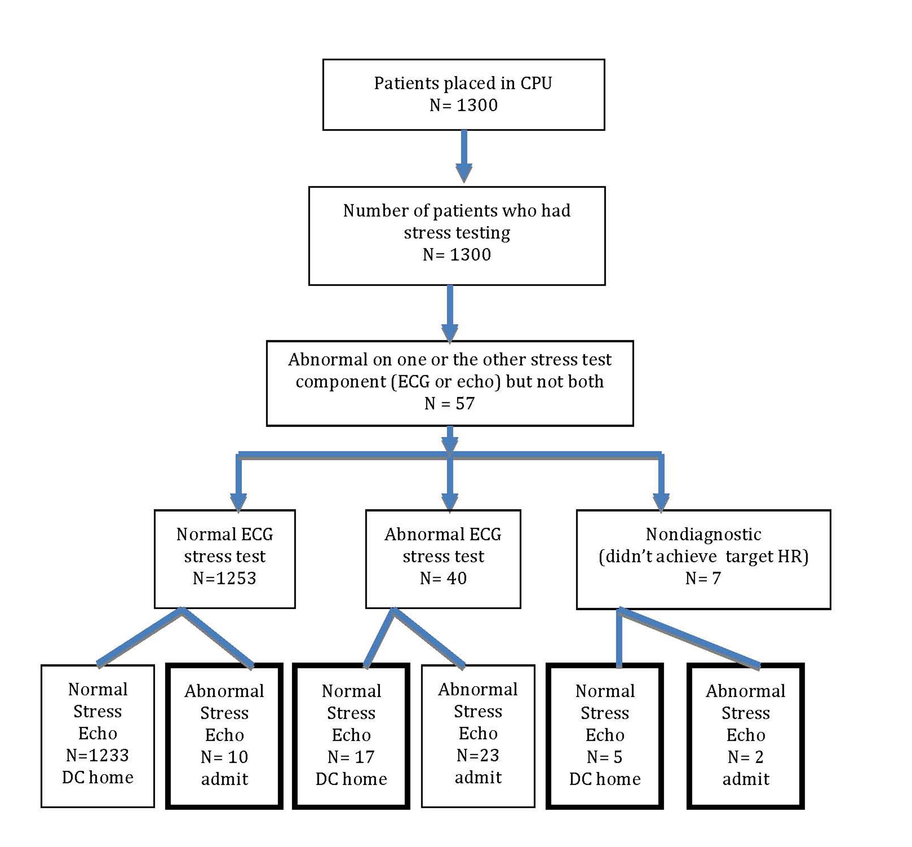

Slide 4
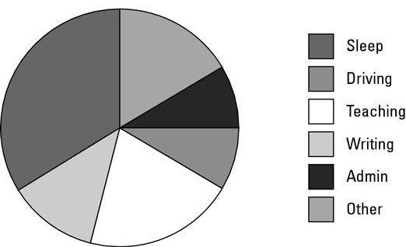

Slide 5
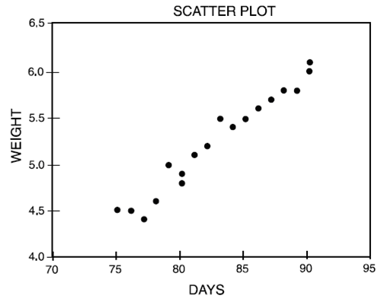
Notes:
scatter plot

Slide 6
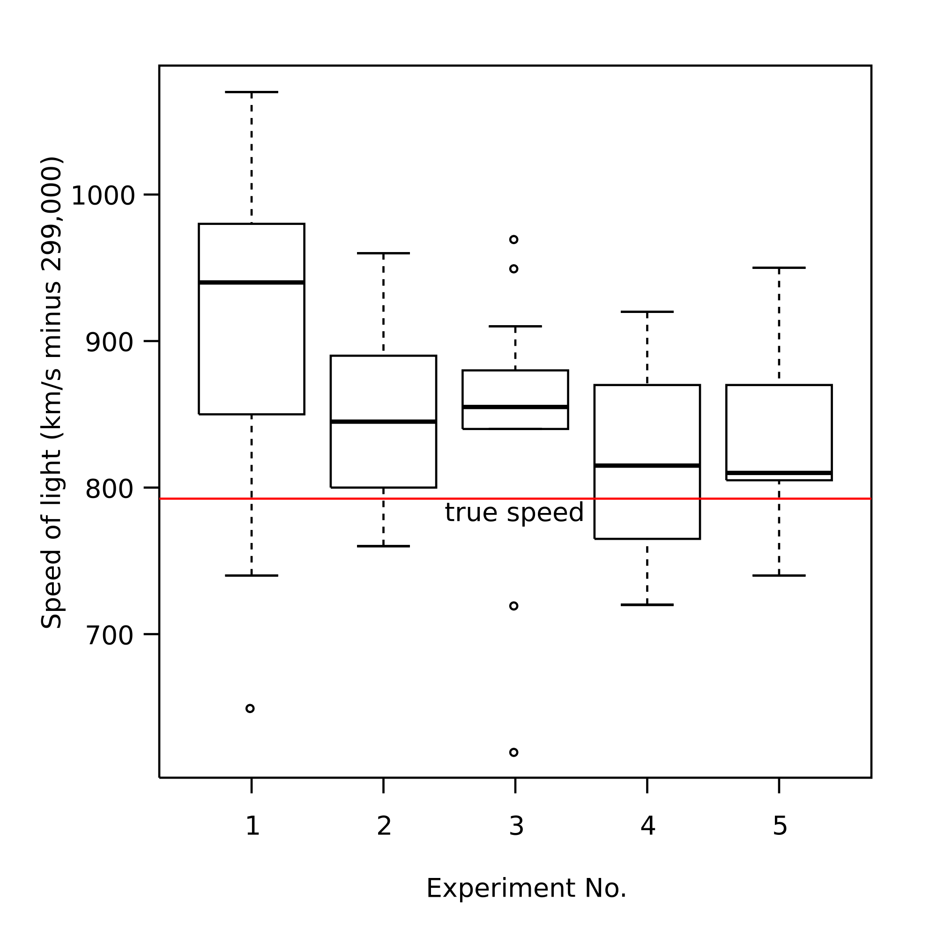
Notes:
A box plot / a box-and-whiskers graph

Slide 7
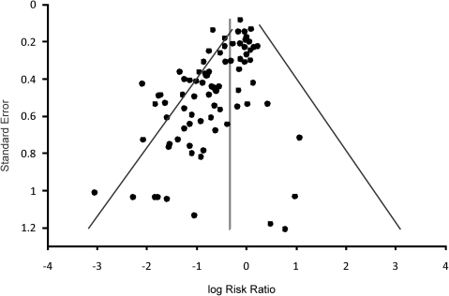
Notes:
A funnel plot

Slide 8
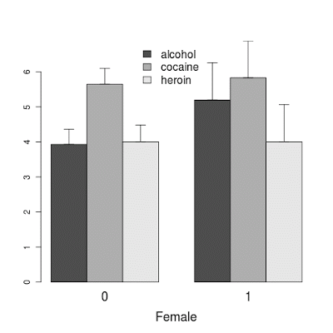

Slide 9
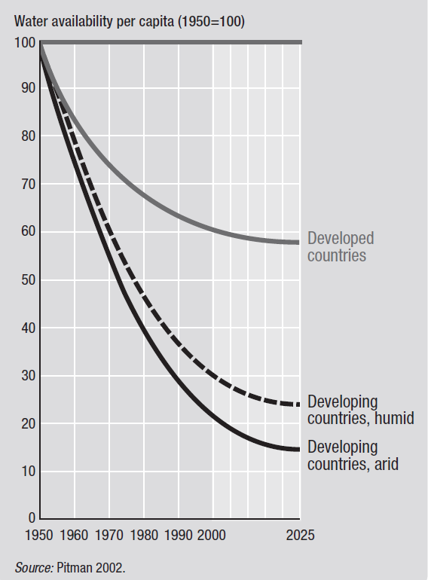

Slide 10
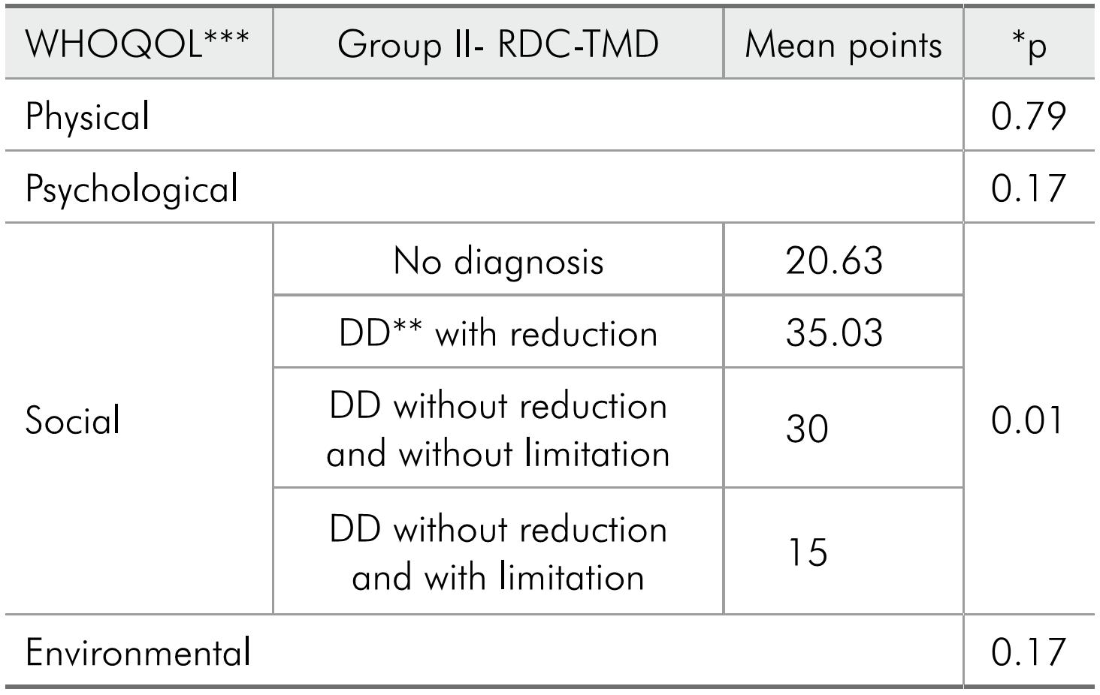

Slide 11
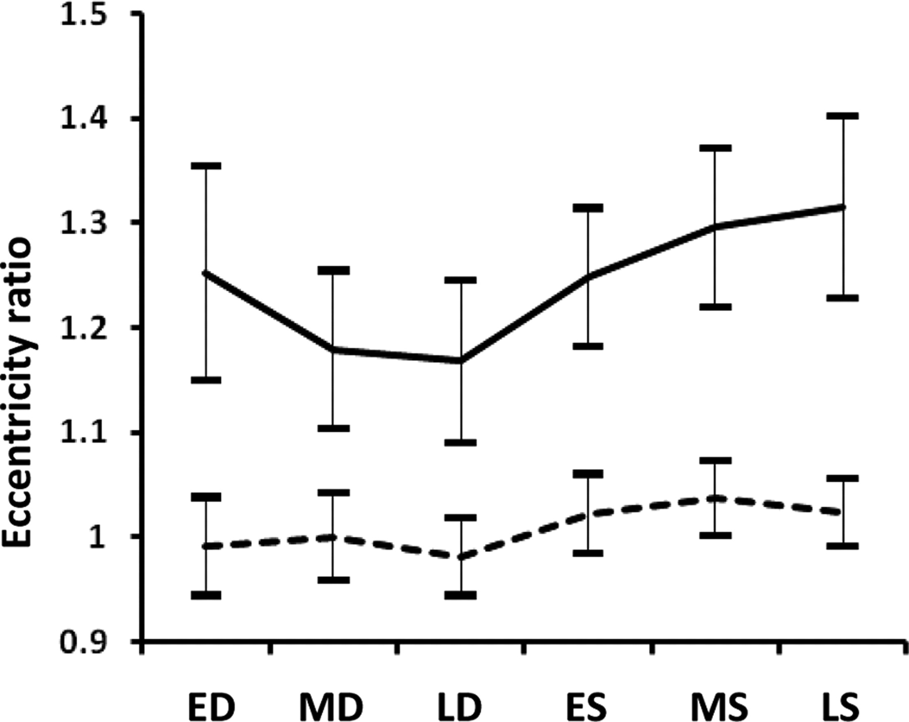

Slide 12
match the figures
Student A: figure 1, 2…
Student B: figure a, b…
Match the numbers to the letters

Slide 13
where’s the pointer?
.
Notes:
sit back to back
one student describes the location of the pointer so the other one can draw it on the corresponding figure

Slide 14
.

Slide 15
.

Slide 16
.

Slide 17
.
Notes:
scatter plot

Slide 18
.

Slide 19
switch with your partner

Slide 20
.

Slide 21
.

Slide 22
.

Slide 23
.

Slide 24
.

Slide 25
THE CONVERSATION
You are going to record a podcast called THE CONVERSATION for a student website.
Prepare a dialogue with another group about the topic of your English presentations.
Ask each other questions, give developed answers.
Pay attention to pronunciation and intonation… make it sound good, make it sound natural!
Prepare to speak for 5 minutes.

Slide 26
IDEAS
Start by introducing the yourselves and the topic… today we’re going to be talking to… about…
Write the script – questions and answers:
What topic have you chosen for your project?
What did you know about the topic before?
Why is your topic important for medical students?
Can you explain the basic principles behind it?
What ideas do you have for your presentation?
What questions would you like to ask / answer?
Notes:
If short of time or slow starting…

Slide 27
START RECORDING
Record what you have scripted.
If you don’t reach 5 minutes… improvise for the last part

