Slide 1
Today’s menu…
Using effective oral communication strategies
Reviewing some grammar & vocabulary

Slide 2
Standing stairs
Where do you see yourself in 10 years time?
What is your biggest weakness?
How would your friends describe you?
What are you most proud of? & Why?

Slide 3
Effective Oral Communication Strategies

Slide 4
Think about the presentations / talks you have seen
What do the good speakers do?
What do the bad speakers do?
Make a list:
Effective Strategies | Ineffective strategies

Slide 5
Think about the presentations / talks you have seen
What do the good speakers do?
What do the bad speakers do?
Make a list:
Effective Strategies | Ineffective strategies
Illustrate what they say: pictures, videos – easier to follow, helps to focus on message, helps us to visualise the idea Keywords/phrases Speak at the right pace/rhythm Clear speech, pronunciation Use examples Intonation / meaning / teaching / explaining Adapt your speech to your audience: common words, vulgarised the info Good posture: Standing straight, smiling, dynamic but at ease | Don’t overload with info / select what is important → Less is more? Unprepared: content & language

Slide 6
Think about the presentations / talks you have seen
What do the good speakers do?
What do the bad speakers do?
Make a list:
Effective Strategies | Ineffective strategies
Look at your audience/camera Gesture to the slides Link the information / logical connections Organised & structured: plan Hand gestures/mouse cursor/use language to point at information Using examples & analogy Plan, prepare & practice | Reading – not dynamic, no contact with the audience, monotonous voice Talk too much, too fast Not passionate → so we are not involved/in the presentation Too quiet, not projecting their voice, use microphone/headphones

Slide 7
Think about the presentations / talks you have seen
What do the good speakers do?
What do the bad speakers do?
Make a list:
Effective Strategies | Ineffective strategies
Speak clearly, slowly, loudly Interact: look at people, ask questions Simple language Humour Visual supports Highlighting important info Transitions | Too much repetion Not fluent

Slide 8
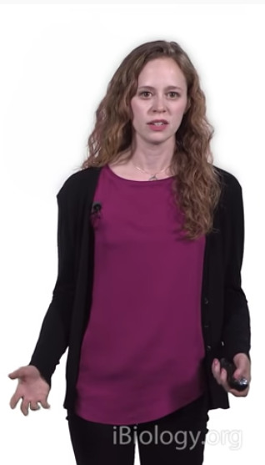
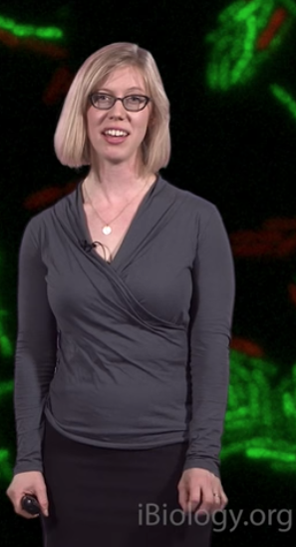
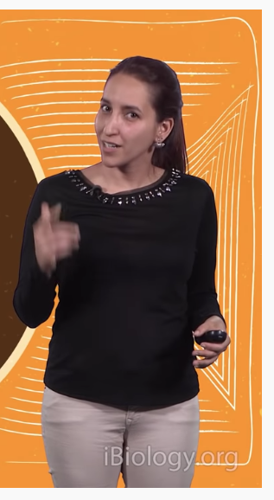
Three Research Stories: Effective Oral Communication Strategies

Slide 9
Three research stories…
Separate the cards into 3 different scientific presentations
Each student takes 1 presention to focus on
Listen to the presentation check the order is correct
Take notes about the effective communication strategies used by scientist
use the transcript and coding grid to help – quote or paraphrase
Share your findings with your group

Slide 10
Three research stories…
In the quiz
Read the texts & separate them into 3 different texts. Try to put them into the correct order.
Check your answer by listening to the video.
Use the Effective oral communication strategies grid to analyse the presentation. Take notes on the communication strategies used.

Slide 11
Darienne Myers (UCSF): A Mouse Model to Understand Lupus
https://youtu.be/kQeYkjHEPtY
Dr. Michele LeRoux (MIT): Pseudomonas aeruginosa survives with a gut reaction using their T6SS
https://youtu.be/GCw35RKBF70
Filipa Rijo-Ferreira (UTSW): Circadian Rhythms of the African Sleeping Sickness Parasite
https://youtu.be/W0NWUSy30MM

Slide 12
Effective Oral Communication Strategies
CODE | STRATEGY | DEFINITION | EXAMPLES (quote or paraphrase)
[1] | pre-focusing | leading into the research topic with an easy to understand hook
[2] | storytelling | telling a story related to the research topic
[3] | question-raising | asking direct questions
[4] | rapport-building | connecting / identifying with your audience
[5] | using metaphor | comparing scientific concepts to non-scientific concepts
[6] | signposting | using expressions to direct your audience’s attention
[7] | defining | explaining the meaning or origin of terms
[8] | paraphrasing | explaining concepts in alternative terms
[9] | transitioning | showing that you are moving from one idea to the next
[10] | highlighting | drawing the audience’s attention to important ideas
[11] | recapping | repeating or summarising what has already been said
[12] | illustrating | giving examples

Slide 13
Over to you…
Plan the script/keywords for the opening 3-4 minutes of your presentation.
Use the strategies grid to guide you.
What are the questions you will answer in your introduction?
What is the background to this science?
Why is this science research important?
How is this science applied/important to our everyday lives/pure research/fundamental science?
How would you define / explain the key concepts? What examples would you give to illustrate the idea?
What research has already been done in this area? What do we already know? How was this found?
What do we not know? What is the gap in the knowledge? What do you plan to do to try to fill this gap?

Slide 14
Oral Presentation Guidelines

Slide 15
Homework
Send research propsal / abstract before Tuesday 19 Nov
Have presentation ready for 20 Nov to practice

Slide 16
Difficult questions
Why do interviewers ask difficult questions?
What difficult questions might interviewers ask?
How can they find out what you are like as a person?
Your personality
How do you deal with stress?
What are you like as a colleague?
How will you deal with responsibility?

Slide 17
Your job application
Tell me about yourself.
Why did you choose this particular job?
Why did you choose this particular company?
What knowledge & skills do you have that match this job?
Why do you think you are the best person for this job? We have 7 other students with a master’s in regulatory affairs, so why should we choose you?
What are your strengths and weaknesses?
How would you imagine a working day in our department?

Slide 18
Possible Presentation structure
Present the company / yourself
Present the job
How your skills & experience match the job
How will you make yourself stand out?
Examples / stories / experience / presentation structure
What’s so special about this master’s? How does it make you different? What have you gained from doing it?
Personality traits: reliable, curious, rigorous → be able to justify, give examples
Upload CV & job ad to formatoile before by Monday evening 13/12

