Slide 1
Musical memory in a patient with severe anterograde amnesia
Cavaco and al, 2012
J Clin Exp Neuropsychology

Slide 2
Musical memory in a patient with severe anterograde amnesia
Find the different sections: Intro, Question, M&M, Results, Discussion
Abstract
The ability to play a musical instrument represents a unique procedural skill that can be
remarkably resilient to disruptions in declarative memory. For example, musicians with severe anterograde amnesia have demonstrated preserved ability to play musical instruments. However, the question of whether amnesic musicians can learn how to play new musical material despite severe memory impairment has not been thoroughly investigated. We capitalized on a rare opportunity to address this question. Patient SZ, an amateur musician (tenor saxophone), has extensive bilateral damage to his medial temporal lobes following herpes simplex encephalitis, resulting in a severe anterograde amnesia. We tested SZ’s capacity to learn new unfamiliar songs by sight-reading following three months of biweekly practices. Performances were recorded and then evaluated by a professional saxophonist. SZ demonstrated significant improvement in his ability to read and play new music, despite his inability to recognize any of the songs at a declarative level. The results suggest that it is possible to learn certain aspects of new music without the assistance of declarative memory.

Slide 3
Musical memory in a patient with severe anterograde amnesia
Introduction § 1
What are the causes of dense amnesia?
What can they still perform?
What still remains intact in those patients?

Slide 4
Musical memory in a patient with severe anterograde amnesia
Introduction § 1
What about results concerning the mirror reading task in amnesic patients?
What does this dissociation lead to? Explain it
Which one still remains intact in those patients?
Why are the authors interested in musical performance?

Slide 5
Musical memory in a patient with severe anterograde amnesia
Introduction § 2
What do case reports reveal?
What kind of music are they able to play?
What remains unknown concerning Clive Wearing?

Slide 6
Musical memory in a patient with severe anterograde amnesia
Introduction § 3
Classify results from the 5 case studies concerning the ability to learn new songs (Pros Cons, no results)
Pros | cons | Confounding results
To conclude:

Slide 7
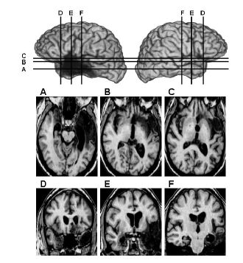
Musical memory in a patient with severe anterograde amnesia
M&M
Pick up information concerning the patient (description and neurological exam)
Neurological exam

Slide 8
Musical memory in a patient with severe anterograde amnesia
M&M
Neuropsychological assessment
Cognitive areas | Preserved | Non preserved
Declarative memory
Procedural memory
Working memory
IQ
Language
Spatial orientation
Mood

Slide 9
Musical memory in a patient with severe anterograde amnesia
M&M
Musical experience before illness
Musical experience after illness
Find 2 strange anecdotes illustrating the severity of SZ’s memory impairment

Slide 10
Musical memory in a patient with severe anterograde amnesia
M&M
Procedures
Stimuli
Experimental paradigm
Performances assessment

Slide 11
Musical memory in a patient with severe anterograde amnesia
Results
Declarative memory

Slide 12
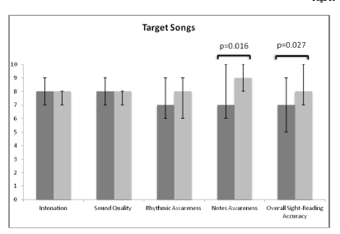
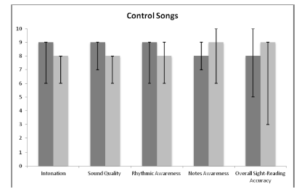
Musical memory in a patient with severe anterograde amnesia
Results
Musical performance

Slide 13
Musical memory in a patient with severe anterograde amnesia
Discussion
Summary of the results
Neurological discussion
Why was a control group not necessary?

Slide 14
Musical memory in a patient with severe anterograde amnesia
Discussion
Limitations of the study
How do the authors explain the piecemeal (step by step) improvement in SZ’s musical memory?

Slide 15
Musical memory in a patient with severe anterograde amnesia
Discussion
Sound quality, intonation and rhythmic awareness were not improved. Why?
General conclusion

