Slide 1



M2 Macrophage polarization induced by endothelial cells triggers fibrosis in systemic sclerosis
Joe Bloggs
Under the direction of
Jane Doe, MCU-PH
CNRS-UMR5164 Immuno-ConcEpT

Slide 2
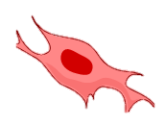


Pathogenesis of Systemic Sclerosis
Endothelial cells
VASCULOPATHY
???
Fibroblasts
Macrophages
Macrophage polarization
???
P
IMMUNE SYSTEM ABNORMALITIES
FIBROSIS
M2-like
Notes:
However, we don’t know the molecular actors involved in this process.

